Slide 1

Students’ Adaptability Level in Online Education during COVID-19
CISC 525 Big Data Architecture
Final Project
Instructor: Sangwhan Cha, PhD
Srikanth Guttikonda

Slide 2
Agenda
Background
Project Goal
Data
Tools and Architecture
Results
Conclusions

Slide 3


Background
Factors Affecting Student Adaptability to Online Education during COVID-19
Learning environment:-
The physical space in which
student's study can impact on their
ability to adapt to online learning
and the quality of their work.
Time management skills:-
Students need to be able to manage their time effectively
To complete coursework and
Participate in online classes.

Slide 4


Background
Technological Literacy:-
Students need to be able to
Use a range of technologies
And platforms to participate in
online classes and complete
Assignments.
Teacher-Student Relationship:-
The relationship between students
And teachers can have a significant
Impact on a student adaptability to
Online education.

Slide 5
Project Goal
RESEARCH QUESTION:
How well have students adapted to online education?
In this project, Big Data Tools and algorithms will be used to answer the research question and help understand what causes high and low adaptability levels.
This prediction can be used as input by the management of a school to help determine the class format for every batch of students.
This project can also help determine if online school can be an option for some students.

Slide 6

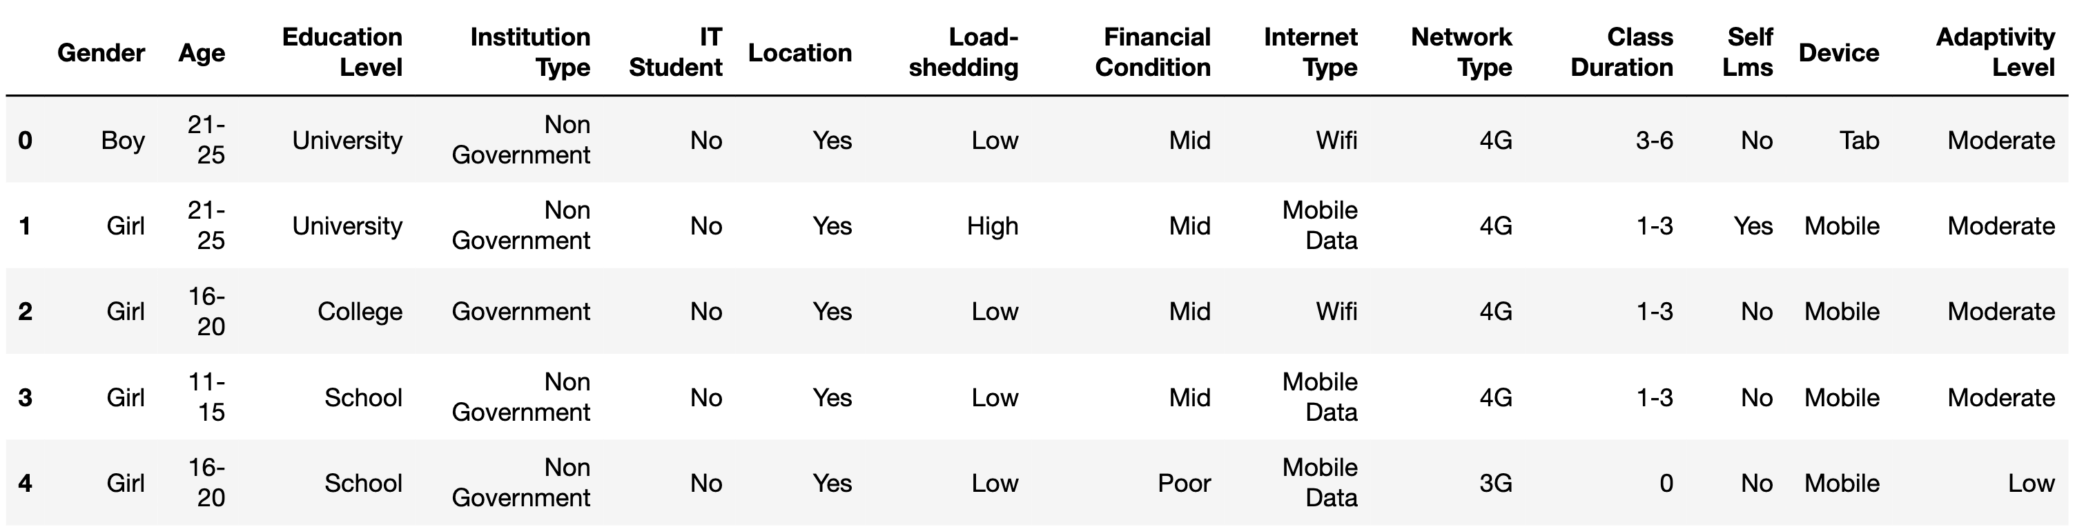
Data
Source: Kaggle
Information collected using surveys (from Dec 2020 to Feb 2021) on the different levels of education (school, college and university)
14 attributes and 1,205 observations
All variables are categorical
Target: Adaptivity Level

Slide 7
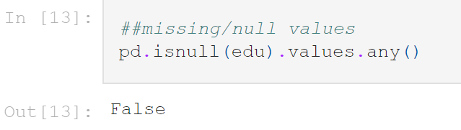
Data Preprocessing
Checked for missing values – none reported
Checked for duplicated values – none reported
Used Pandas API for this (Python)

Slide 8
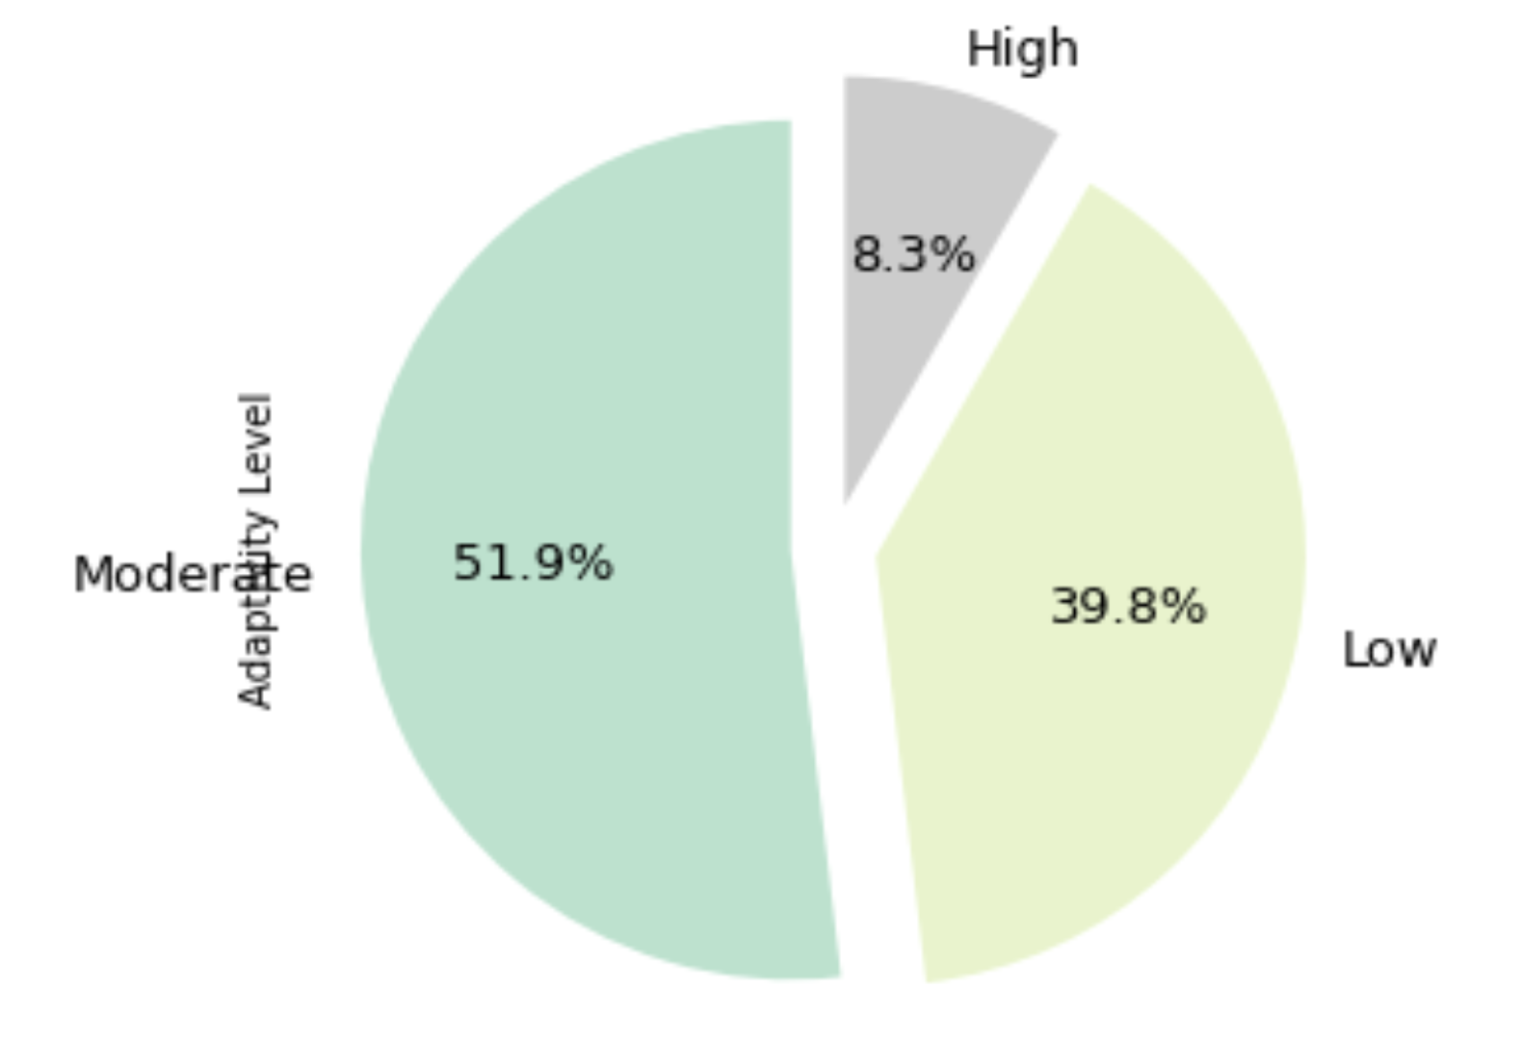
Exploratory Data Analysis
Target variable "Adaptability Level"
The data is not imbalanced

Slide 9
Tools
Google Cloud – Dataproc Hadoop System
MapReduce
Spark
Tableau
Python

Slide 10

Hadoop/Google Cloud
Open-source tool used for big data processing
Is efficient in storing large amounts of data
$300 credit before paying for the resources

Slide 11

Python
Open-source programming language
High-level, general use programming language
Lots of API’s and Libraries available
Adaptable with lots of other tools

Slide 12

MapReduce/Spark
Spark is an open source, distributed computing system designed for bigdata processing and analytics. It was developed by Apache software foundation.
Spark can be used for various data processing tasks, including batch processing, real time data streaming, machine learning, graph processing and more.

Slide 13

Tableau
Tableau is a powerful and widely used data visualization​ and business intelligent software.
Tableau provides an interactive interface that enables users to create interactive dashboards, reports and charts without the need for extensive coding.
It is widely used for data analysis, reporting and decision-making purposes.

Slide 14
Architecture
Data Collection and Storage
Data Processing
Data Visualization
Data Analysis

Slide 15
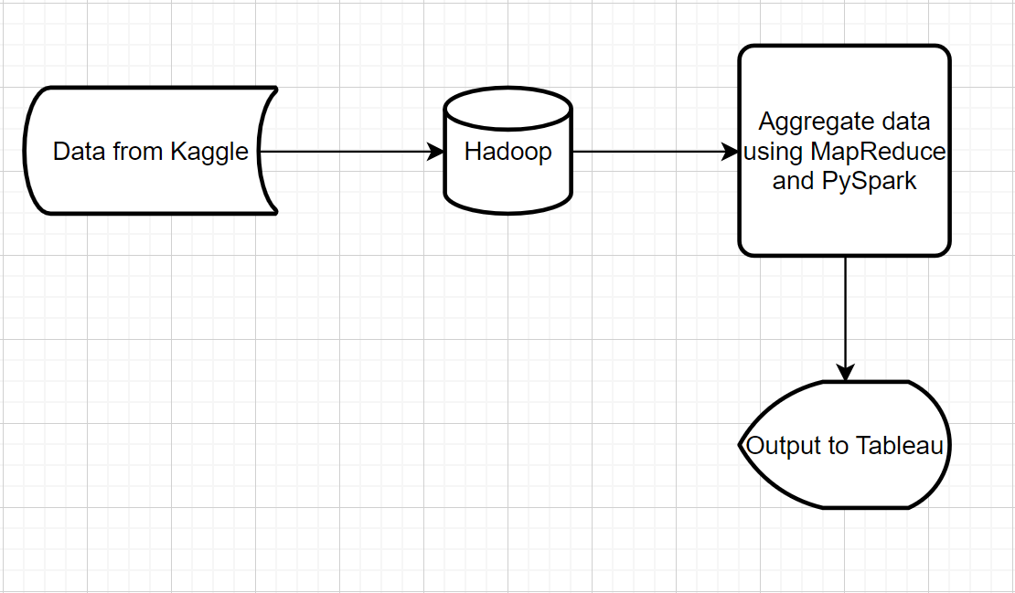
Data Flow Diagram

Slide 16
Data Collection/Storage
Data is uploaded to a Hadoop System
Loaded into PySpark as a DataFrame Object

Slide 17
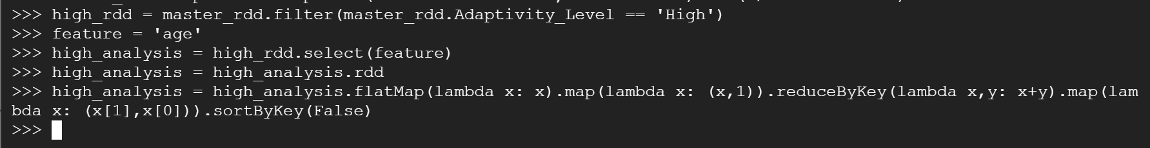
Data Processing
The data is processed based on the Adaptability Level
Transformed into key/value pair
Easier to analyze
All necessary features undergo the same processing

Slide 18
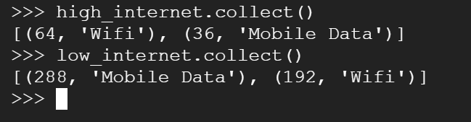
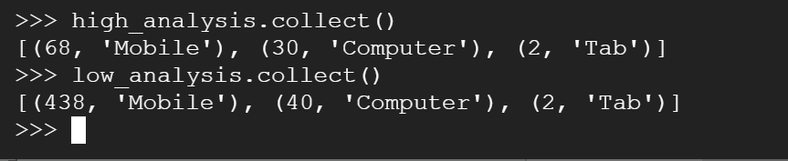
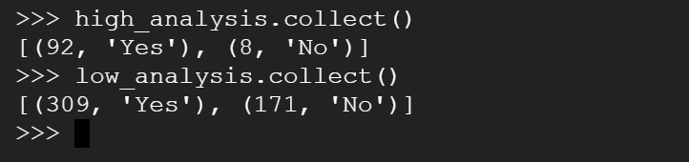
Data Analysis/Output

Slide 19
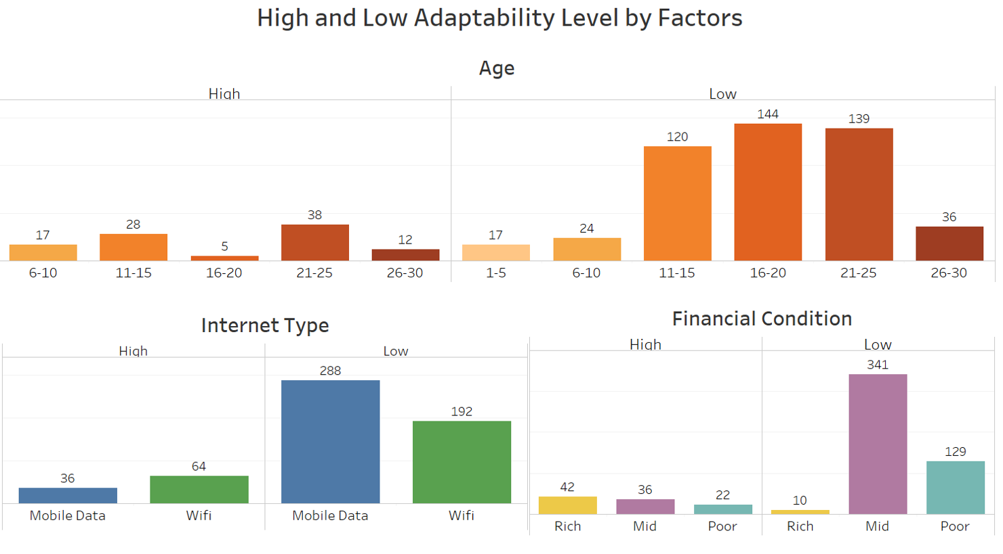
Data Visualizations

Slide 20
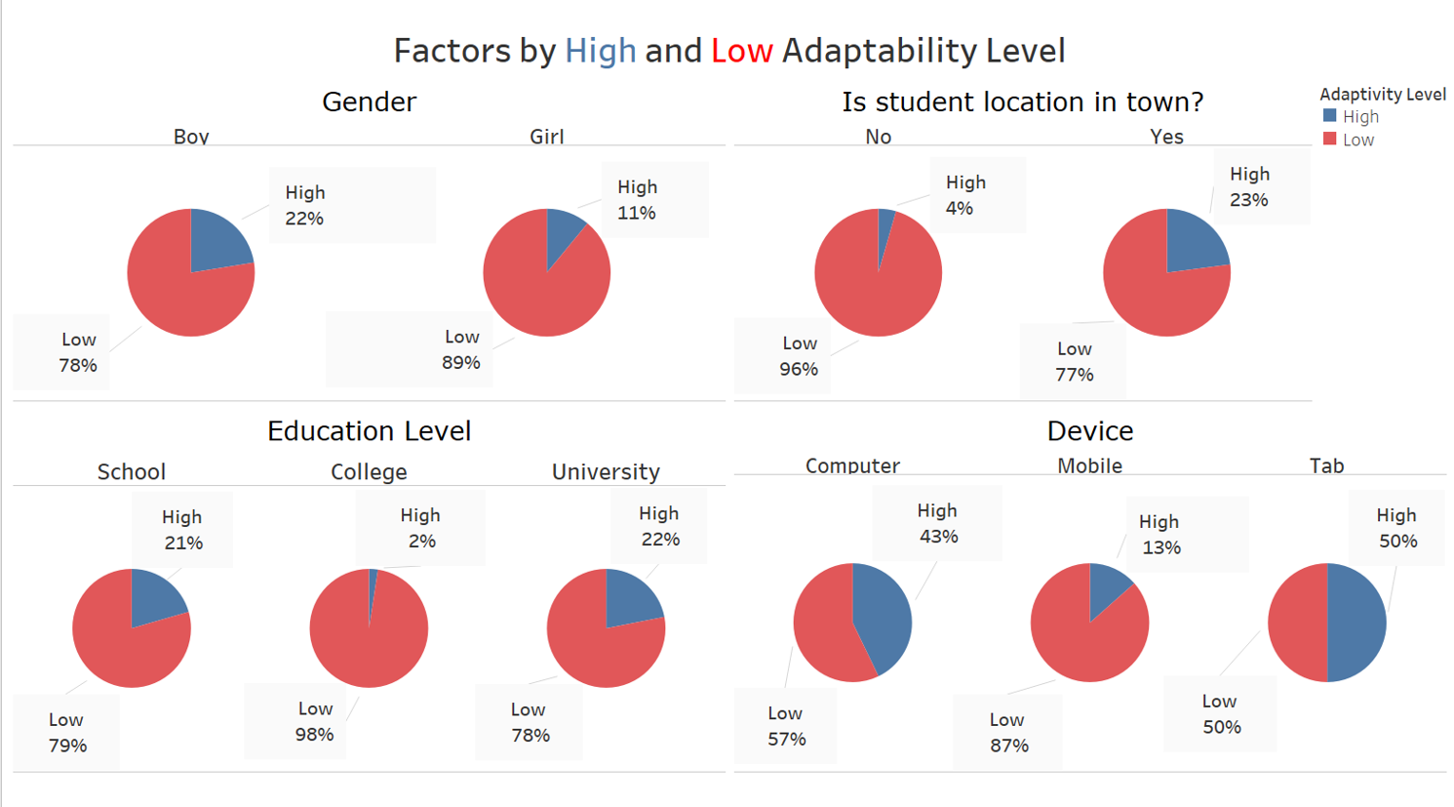
Data Visualizations

Slide 21
Conclusions
Students using Mobile devices and Mobile Data tend to have a lower adaptability level
Students living in the town seem to have a better chance of adapting to online learning than those who live in rural areas (internet connection is limited)
11-15- and 16–20-year-old groups had the hardest time adapting

Slide 22
Conclusions
Students enrolled in a School or University have higher percentages of high adaptability compared to students in College

Slide 23
References
https://www.kaggle.com/datasets/mdmahmudulhasansuzan/students-adaptability-level-in-online-education
Suzan, M. H., Samrin, N. A., Biswas, A. A., & Pramanik, A. (2021, July). Students' Adaptability Level Prediction in Online Education using Machine Learning Approaches. In 2021 12th International Conference on Computing Communication and Networking Technologies (ICCCNT) (pp. 1-7). IEEE

Slide 24
THANK YOU!

